Slide 1

The Need for DevOps

Slide 2
Topics
Understanding a world outside of DevOps

Slide 3









Software Development never ends...
Code
Deploy
Plan
Build
Operate
Release
Test
Monitor

Slide 4


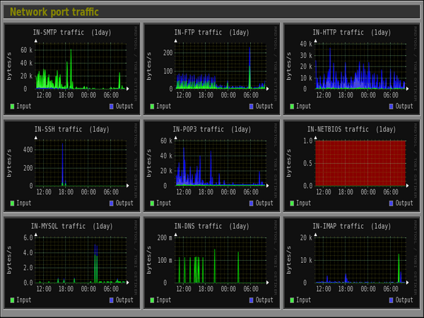
Common Problems DevOps Attempts to Solve
Request for More Server Capacity:
We need to increase our server capacity to handle the growing demand.
Testing in Production:
“Wouldn’t it be great if we could test our system directly in the production environment?”
Accountability for Issues:
An issue has occurred. Who is responsible?
Monitoring System Alerts:
We get meaningless alerts!

Slide 5
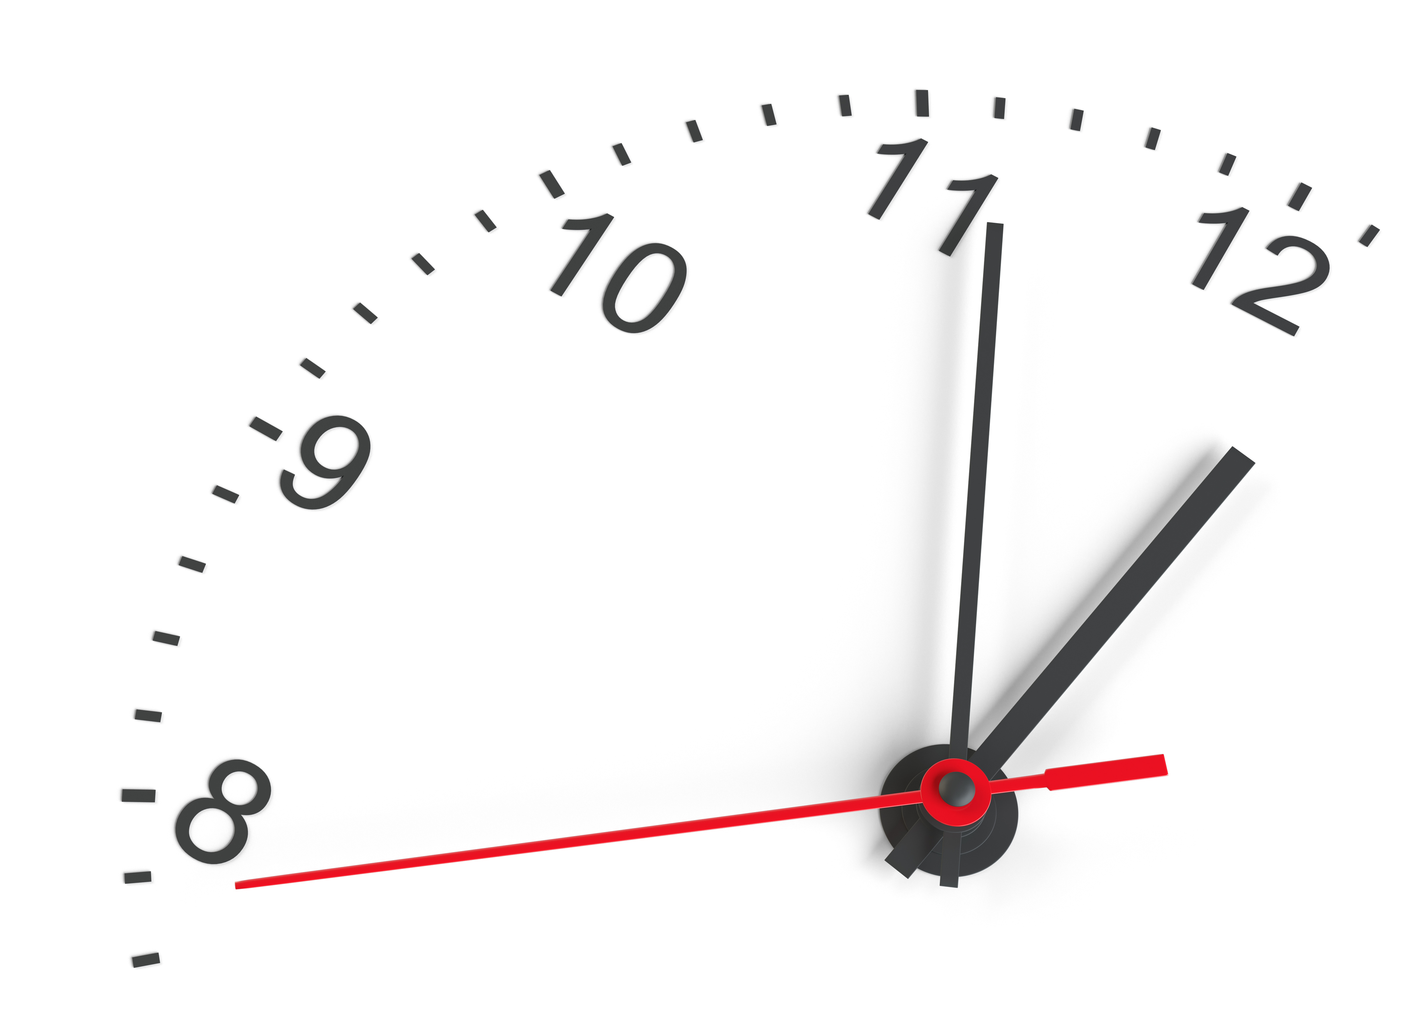

Common Problems DevOps Attempts to Solve
Test Automation Concerns:
No time to test everything, but we have time to fix avoidable issues!
Resource Allocation:
Too busy to allocate time and resources, as it might detract from critical systems development. But we’ve the time to fix the problems that could have been avoided!
Single Point of Failure:
A single developer has become a single point of failure
Spf ☢️

Slide 6
I need more server(node) capacity
The most common complaint from the business
Ops team are now seen as blockers who are not sensitive to the needs of business
Capacity demand often fluctuates without clear reasons
Ops teams manage more than just your app:
System outages
System defects
Incident & Security Management
Resource and Budget Management
Monitoring and Improving KPIs
Compliance…
Notes:
I need more server (node) capacity

Slide 7

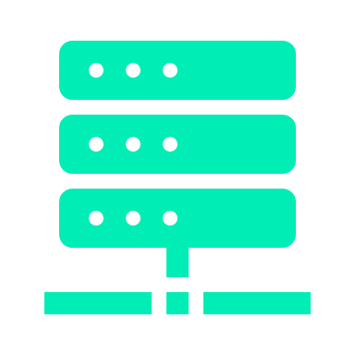
Let me test my app on the live environment!
I’m sure everything is working…
I need access to something like the production environment to really test what I’ve built
Developer
environment
Production
environment
Notes:
Wouldn’t it be great if I could test my system on the production environment?

Slide 8



Another Problem – Who caused it this time?
Production
environment
Who should we
take aim at?
Dev Team
Business
Dev Team: Why can’t build software that works?
Ops Team: Why can’t you get the capacity right?
Notes:
Something went wrong, whose fault was it?

Slide 9
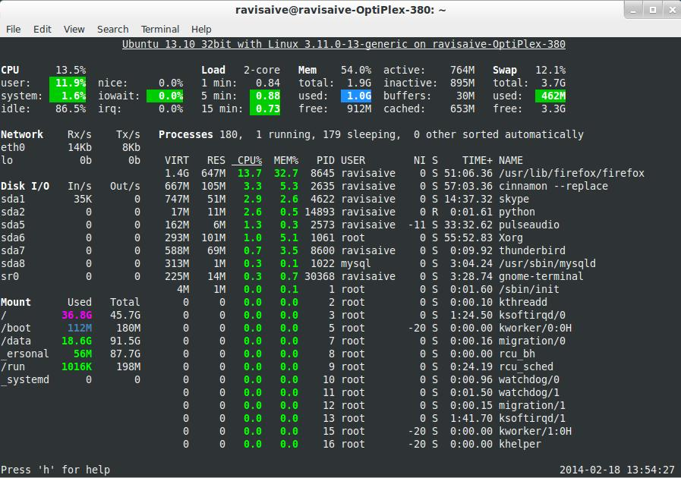
Nothing here is making sense, there’s too many alerts!
Alert fatigue…
Alerts become meaningless
This Monitoring System is crazy…
Production
environment
Application and Network Performance Management Systems
Notes:
Monitoring System alerts are becoming meaningless

Slide 10


Wall of confusion
The wall of confusion
I want change!
I want stability!
Dev
Op
What about Security, Governance, Risk Management and Compliance?
OPs wants to maintain stability, availability
Dev wants to create change - Conflicting views
Notes:
Emote/RP this out -
DW and ?

Slide 11
Wall of
confusion
Wall of confusion
Oh, these Ops guys
don’t get it
Oh, these developers
don’t get it
Dev
Op
Notes:
DW and ?

Slide 12
(Lack of) DevOps - Case Study
Read the case study
In pairs, discuss...
What was going wrong on the project?
What could people have done differently to improve things?
Do you have any experience / examples of similar horror stories?
As a group, we'll hear everyone's feedback, and review

Slide 13
THANK YOU
Hope you enjoyed this learning journey.

